Slide 1
Understanding Risk
Notes:
What do we mean when we talk about risk?

Slide 2
Risk is the likelihood and impact of an event that you aren’t certain will occur.
Notes:
Ask 10 people for a definition of risk, and you’re likely to get at least a dozen answers. For our purposes, risk is the likelihood and impact of an event that you aren’t certain will occur.

Slide 3
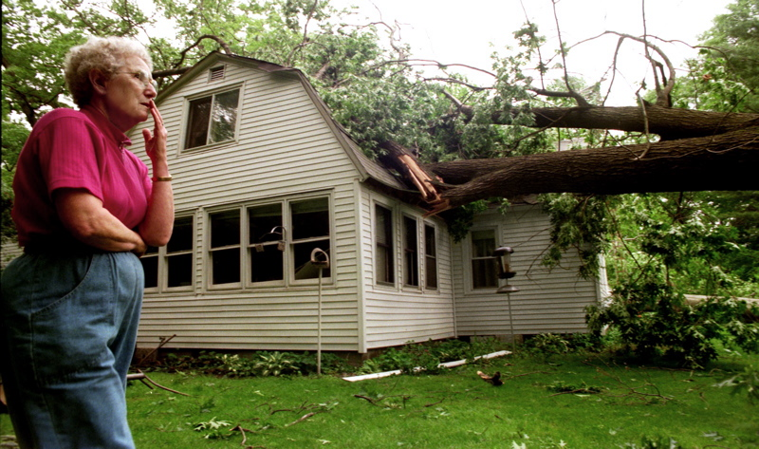
Notes:
Let’s take the second part first: Risk requires uncertainty. The possibility that the tree in your backyard will die is not a risk. All trees die; it’s guaranteed.
But the possibility that it will die within the next five years, or that it will be uprooted in a storm and fall on your house? –Those are both risks. They’re possible, but you don’t know if they’ll actually occur

Slide 4
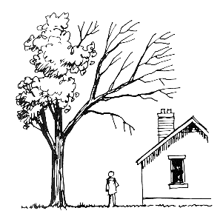
Understanding Risk
Risk = Likelihood x Impact
Likelihood: Probability that a situation will occur.
Impact:
the outcome of that situation.
Notes:
For uncertain events like these, we say that risk is the product of likelihood and impact. Likelihood is the probability that a situation will occur. And impact is the outcome of that situation.

Slide 5
Risk Matrix
Impact
Medium-Low | Medium-High | Highest | Highest | Highest
Medium-Low | Medium-High | Medium-High | Highest | Highest
Lowest | Medium-Low | Medium-High | Medium-High | Highest
Lowest | Medium-Low | Medium-Low | Medium-High | Medium-High
Lowest | Lowest | Lowest | Medium-Low | Medium-Low
Likelihood
Notes:
A common way of visualizing this is by using a risk matrix, which can also be called a heat map. One axis represents likelihood, and the other one represents impact, and the risk of a situation lies at the intersection of these two axes.

Slide 6
Risk Matrix Example
Risk = Likelihood x Impact
Risk = 3 x 4
Risk score = 12
Impact
 | 1 | 2 | 3 | 4 | 5
5 | 5 | 10 | 15 | 20 | 25
4 | 4 | 8 | 12 | 16 | 20
3 | 3 | 6 | 9 | 12 | 15
2 | 3 | 4 | 6 | 8 | 10
1 | 1 | 2 | 3 | 4 | 5
Likelihood
Notes:
In this example, the likelihood of the event is rated as a 3 on a scale of 1-5, and the impact is rated as a 4 on a scale of 1-5] The risk score is the product of these two scores, so in this case it would be 12.

Slide 7
Risk curve example
But risks are often more complex than this.
 | Impact
Likelihood | 1 Negligible | 2 Minor | 3 Moderate | 4 Severe | 5 Very severe
5 Very likely | 5 | 10 | 15 | 20 | 25
4 Likely | 4 | 8 | 12 | 16 | 20
3 Moderately | 3 | 6 | 9 | 12 | 15
2 Unlikely | 2 | 4 | 6 | 8 | 10
1 Very unlikely | 1 | 2 | 3 | 4 | 5
0 Impossible | 0 | 0 | 0 | 0 | 0
Notes:
But risks are often more complex than this. They can usually lead to more than one combination of likelihood and impact. For instance, a healthcare-acquired infection can lead to outcomes ranging from death to no symptoms at all, or anywhere in between. And each of these impacts will have its own likelihood. The risk matrix approach doesn’t really make sense for risks like these. When there isn’t just one level of likelihood and one level of impact, you should use a risk curve instead.
A risk curve shows the likelihood for each level of impact. Let’s look at an example.

Slide 8
Risk curve example
Risk = Likelihood x Impact
Risk =
Neg. 4 x 1 = 4
 | Impact
Likelihood | 1 Negligible | 2 Minor | 3 Moderate | 4 Severe | 5 Very severe
5 Very likely | 5 | 10 | 15 | 20 | 25
4 Likely | 4 | 8 | 12 | 16 | 20
3 Moderately | 3 | 6 | 9 | 12 | 15
2 Unlikely | 2 | 4 | 6 | 8 | 10
1 Very unlikely | 1 | 2 | 3 | 4 | 5
0 Impossible | 0 | 0 | 0 | 0 | 0
Notes:
In this example, negligible harm (an impact score of 1) is rated as likely (a likelihood score of 4). So, just like a risk matrix, we multiply 1 times 4 to get a risk score of 4 for negligible harm.

Slide 9
Risk curve example
Risk = Likelihood x Impact
Risk =
Neg. 4 x 1 = 4
Minor 3 x 2 = 6
 | Impact
Likelihood | 1 Negligible | 2 Minor | 3 Moderate | 4 Severe | 5 Very severe
5 Very likely | 5 | 10 | 15 | 20 | 25
4 Likely | 4 | 8 | 12 | 16 | 20
3 Moderately | 3 | 6 | 9 | 12 | 15
2 Unlikely | 2 | 4 | 6 | 8 | 10
1 Very unlikely | 1 | 2 | 3 | 4 | 5
0 Impossible | 0 | 0 | 0 | 0 | 0
Notes:
We then assess the likelihood of minor harm (an impact score of 2), and find that it is moderately likely (a score of 3). Multiply those together, and we get a risk score of 6 for minor harm.

Slide 10
Risk curve example
Risk = Likelihood x Impact
Risk =
Neg. 4 x 1 = 4
Minor 3 x 2 = 6
Moderate 2 x 3 = 6
 | Impact
Likelihood | 1 Negligible | 2 Minor | 3 Moderate | 4 Severe | 5 Very severe
5 Very likely | 5 | 10 | 15 | 20 | 25
4 Likely | 4 | 8 | 12 | 16 | 20
3 Moderately | 3 | 6 | 9 | 12 | 15
2 Unlikely | 2 | 4 | 6 | 8 | 10
1 Very unlikely | 1 | 2 | 3 | 4 | 5
0 Impossible | 0 | 0 | 0 | 0 | 0
Notes:
Moderate harm is assessed as unlikely, so the score for that is 2 times 3, which makes 6.

Slide 11
Risk curve example
Risk = Likelihood x Impact
Risk =
Neg. 4 x 1 = 4
Minor 3 x 2 = 6
Moderate 2 x 3 = 6
Severe 1 x 4 = 4
 | Impact
Likelihood | 1 Negligible | 2 Minor | 3 Moderate | 4 Severe | 5 Very severe
5 Very likely | 5 | 10 | 15 | 20 | 25
4 Likely | 4 | 8 | 12 | 16 | 20
3 Moderately | 3 | 6 | 9 | 12 | 15
2 Unlikely | 2 | 4 | 6 | 8 | 10
1 Very unlikely | 1 | 2 | 3 | 4 | 5
0 Impossible | 0 | 0 | 0 | 0 | 0
Notes:
Severe harm is assessed as very unlikely, so the score for severe harm is 1 for likelihood times 4 for impact, which of course is equal to 4.

Slide 12
Risk curve example
Risk = Likelihood x Impact
Risk =
Neg. 4 x 1 = 4
Minor 3 x 2 = 6
Moderate 2 x 3 = 6
Severe 1 x 4 = 4
V. severe 0 x 5 = 0
 | Impact
Likelihood | 1 Negligible | 2 Minor | 3 Moderate | 4 Severe | 5 Very severe
5 Very likely | 5 | 10 | 15 | 20 | 25
4 Likely | 4 | 8 | 12 | 16 | 20
3 Moderately | 3 | 6 | 9 | 12 | 15
2 Unlikely | 2 | 4 | 6 | 8 | 10
1 Very unlikely | 1 | 2 | 3 | 4 | 5
0 Impossible | 0 | 0 | 0 | 0 | 0
Notes:
Finally, very severe harm is rated as impossible. Since the likelihood score is a zero, when we multiply that times the impact score of 5, we get a score of zero for very severe harm.

Slide 13
Risk curve example
Risk = Likelihood x Impact
Risk =
4 x 1 = 4
3 x 2 = 6
2 x 3 = 6
1 x 4 = 4
0 x 5 = +0
Risk score = 20
 | Impact
Likelihood | 1 Negligible | 2 Minor | 3 Moderate | 4 Severe | 5 Very severe
5 Very likely | 5 | 10 | 15 | 20 | 25
4 Likely | 4 | 8 | 12 | 16 | 20
3 Moderately | 3 | 6 | 9 | 12 | 15
2 Unlikely | 2 | 4 | 6 | 8 | 10
1 Very unlikely | 1 | 2 | 3 | 4 | 5
0 Impossible | 0 | 0 | 0 | 0 | 0
Notes:
Now that you know the risks for every level of impact, just add them up and you get the risk score for the risk as a whole. You can use these risk scores as a starting point for evaluating which risks require action, and how those risks should be prioritized.

